Slide 1
SEMANTIC Html
march 2017

Slide 2
agenda
INTRODUCTION
SEMANTIC HTML PAGE LAYOUT
NAVIGATION
MARKING UP HTML PAGE CONTENT
MICRODATA
STRUCTURED DATA
ADDITIONAL RESOURCES

Slide 3
INTRODUCTION
What is semantic html?
Semantic HTML is the use of HTML markup to reinforce the semantics, or meaning, of the information in web pages and web applications.
It makes a web page more search engine friendly and more accessible for blind and visually impaired persons.

Slide 4
agenda
INTRODUCTION
SEMANTIC HTML PAGE LAYOUT
NAVIGATION
MARKING UP HTML PAGE CONTENT
MICRODATA
STRUCTURED DATA
ADDITIONAL RESOURCES

Slide 5
Semantic html page layout
Semantic html tags
The <div> is a semantically meaningless element used to group elements together for styling purposes.
HTML5 semantic tags should be used instead of the <div> tag for a webpage layout creation.
The most used tags for that purpose are <header>, <main> and <footer>.

Slide 6
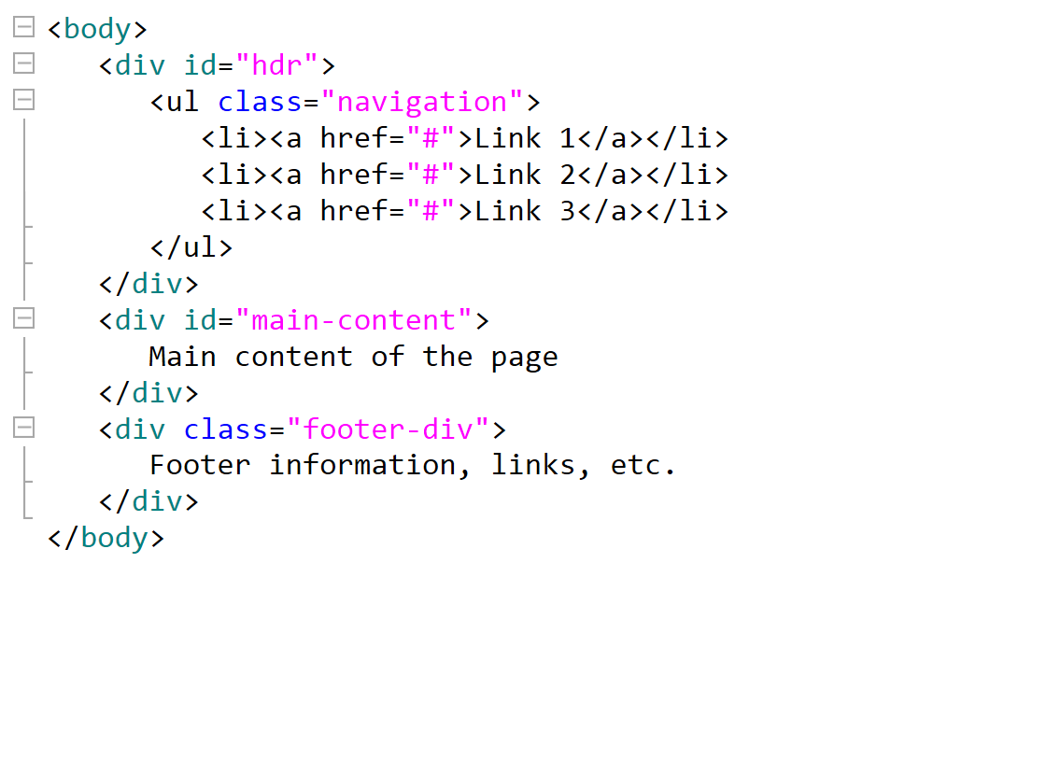
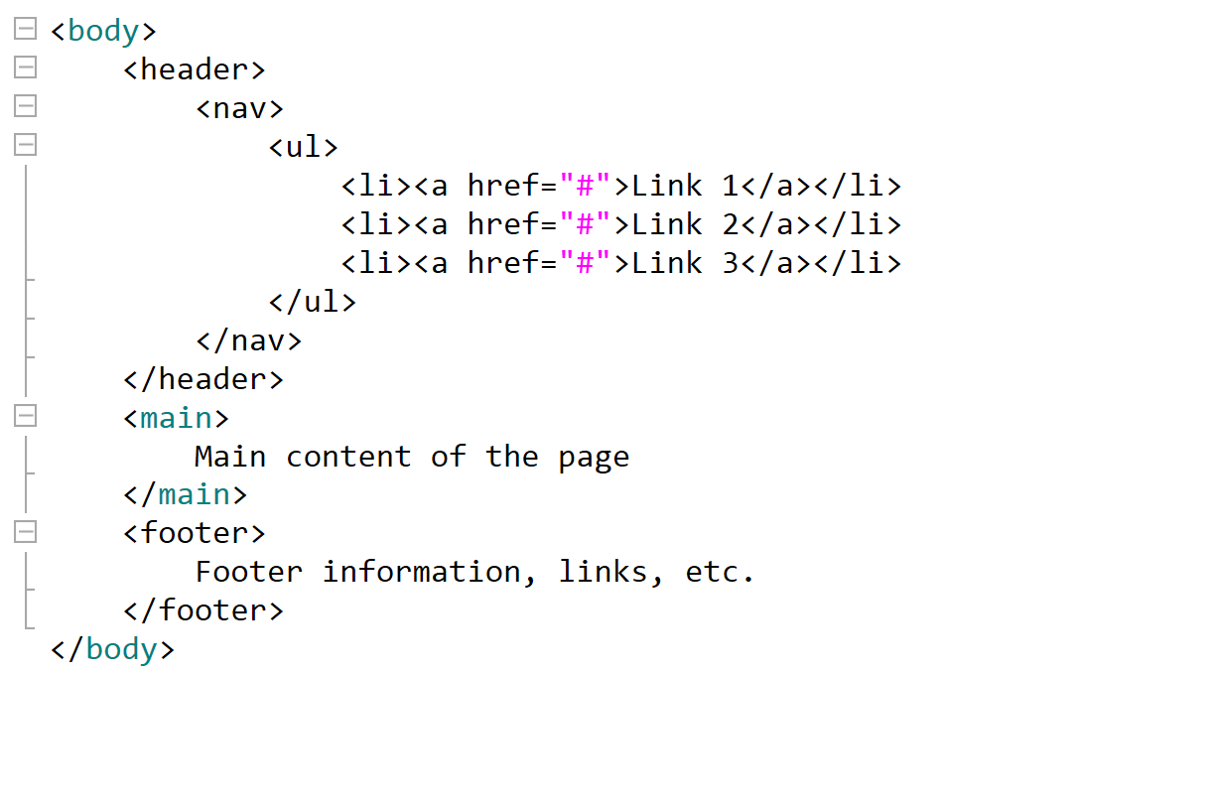
Semantic html page layout
Non-semantic layout
Semantic layout
text
text
TEXT
16%
TEXT
TEXT
text
text

Slide 7
agenda
INTRODUCTION
SEMANTIC HTML PAGE LAYOUT
NAVIGATION
MARKING UP HTML PAGE CONTENT
MICRODATA
STRUCTURED DATA
ADDITIONAL RESOURCES

Slide 8
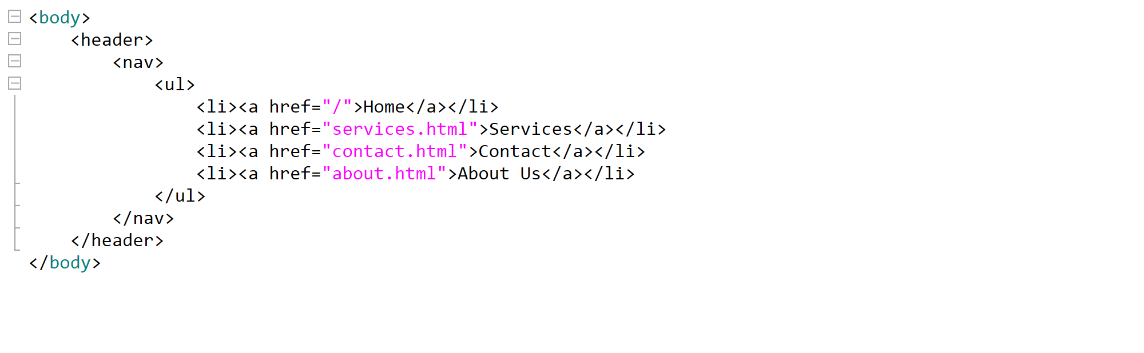
Navigation
The <nav> tag
In HTML5, there is the <nav> tag to wrap links that make a navigation menu.

Slide 9
agenda
INTRODUCTION
SEMANTIC HTML PAGE LAYOUT
NAVIGATION
MARKING UP HTML PAGE CONTENT
MICRODATA
STRUCTURED DATA
ADDITIONAL RESOURCES

Slide 10
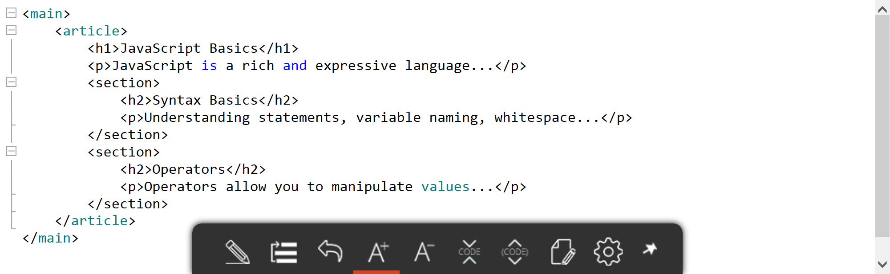
Marking up html page content
Marking up Main content
To add some content into the main section, we can use new HTML5 tags, such as <article> and <section>.

Slide 11
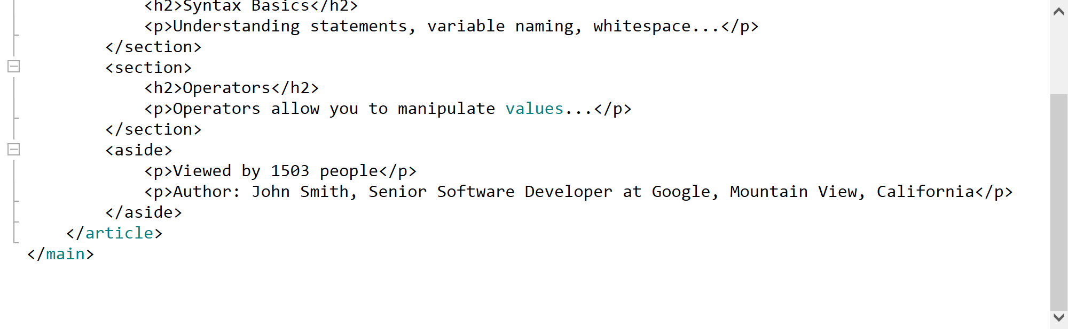
Marking up html page content
Marking up additional content
An additional content, unimportant for understanding an article, but related to the article, can be inserted within the <aside> tag.

Slide 12
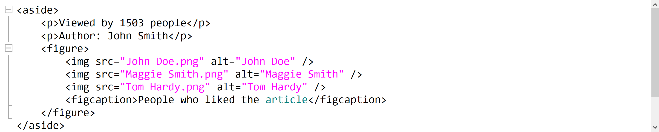
Marking up html page content
figures
Figure elements on a web page can be enclosed with the <figure> and <figcaption> tags.
The <figure> tag is used to mark up photos, code blocks, diagrams, charts, illustrations etc.
The <figcaption> tag represents a caption or legend for a figure. It's optional and can be omitted.
Only one <figcaption> can be nested into the <figure>.

Slide 13
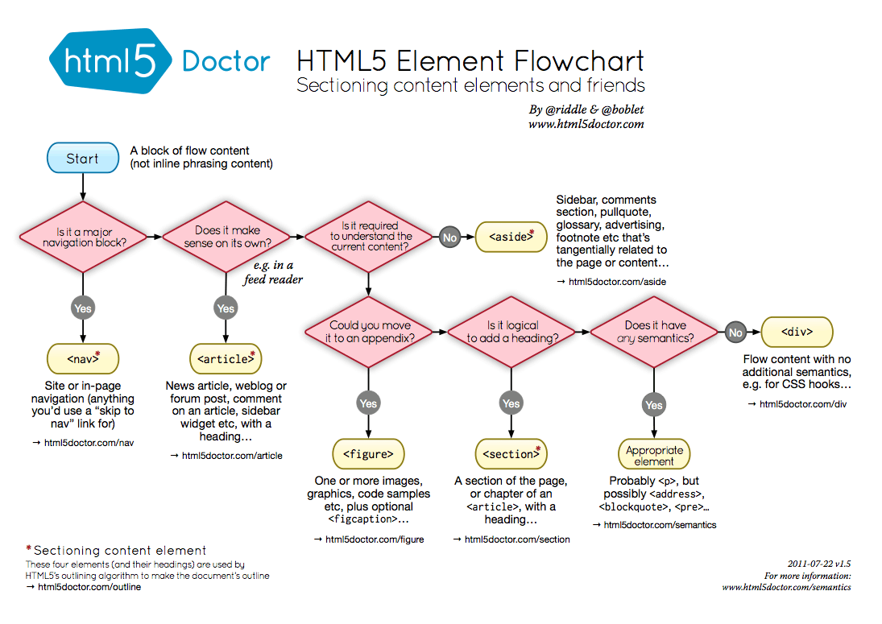
Marking up html page content

Slide 14
Marking up html page content
Browser support
The latest versions of all most popular browsers do support semantic HTML tags.
For some older versions of the IE, Firefox and Safari we need to include the HTML5 Shiv or Modernizr library into a web page, in order to display semantic HTML tags properly.

Slide 15
agenda
INTRODUCTION
SEMANTIC HTML PAGE LAYOUT
NAVIGATION
MARKING UP HTML PAGE CONTENT
MICRODATA
Structured data
ADDITIONAL RESOURCES

Slide 16
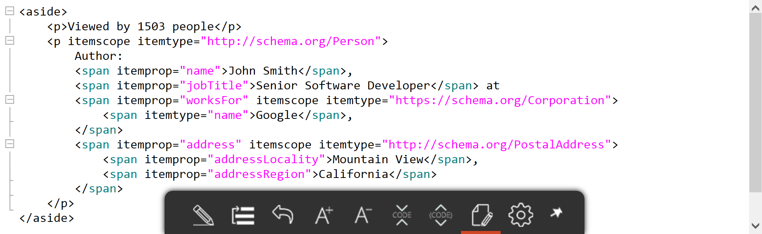
MICRODATA
What do all those words on a web page mean?
Microdata provide additional information about content of a web page and help search engines to understand it better.

Slide 17
MICRODATA
Most used microdata attributes
  itemscope - indicates a new group of microdata (a new item)
  itemtype - type of the item
  itemprop – property of the item

Slide 18
agenda
INTRODUCTION
SEMANTIC HTML PAGE LAYOUT
NAVIGATION
MARKING UP HTML PAGE CONTENT
MICRODATA
Structured data
ADDITIONAL RESOURCES

Slide 19
STRUCTURED DATA
Similar to microdata, but easier for implementation
The structured data markup is represented in JSON-LD format and separated from HTML code.

Slide 20
agenda
INTRODUCTION
SEMANTIC HTML PAGE LAYOUT
NAVIGATION
MARKING UP HTML PAGE CONTENT
MICRODATA
STRUCTURED DATA
ADDITIONAL RESOURCES

Slide 21
Additional resources
  HTML5 structure - div, section & article
  The article element
  Getting started with schema.org using Microdata
  HTML5 semantic elements and Webflow: the essential guide
  How to tag your website with microdata according to Schema.org
  How Using Microdata Can Improve Your Website SEO
  What is Structured Data and Why Does it Matter for SEO

Slide 22
THANK YOU
Miroslav gajic
Senior software developer
miroslav.gajic@endava.com

